Slide 1
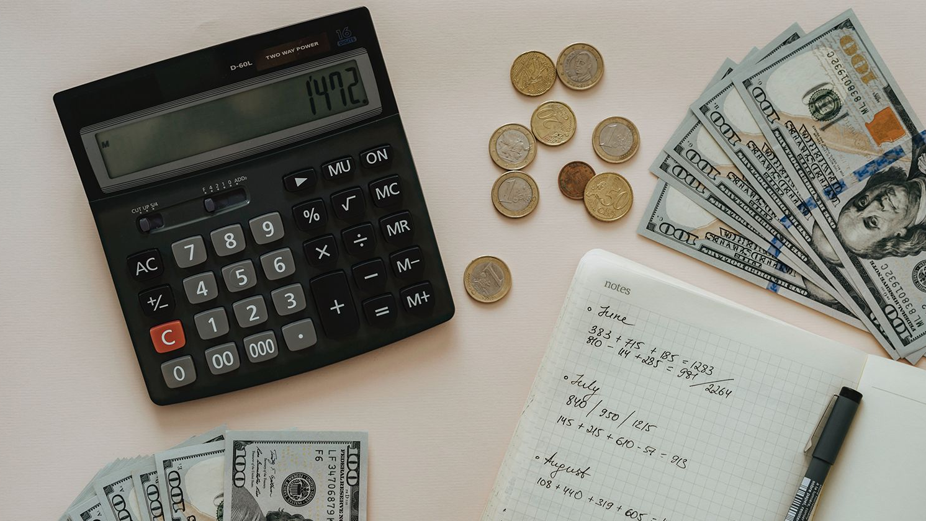

Money Tracker App
With Joppe De Peuter & Stijn Van Raemdonck
Universiteit
Antwerpen
5–Software Design

Slide 2
Money Tracker App
Design Patterns
Diagrams
Tests
Our Secret Sauce
Demonstration

Slide 3
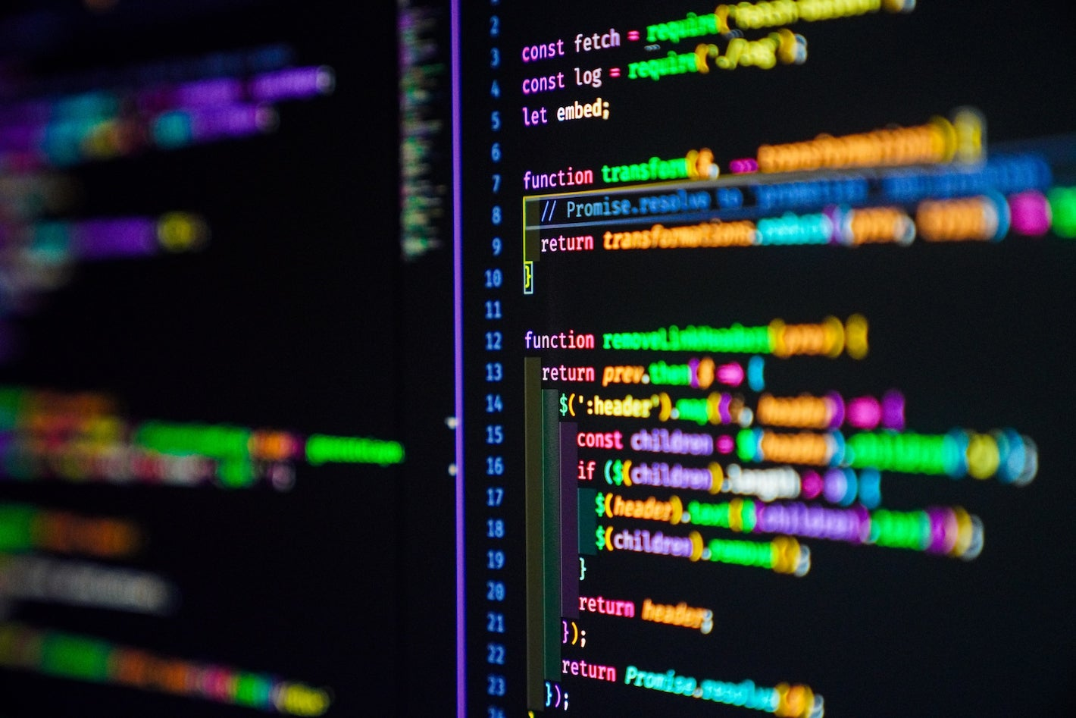
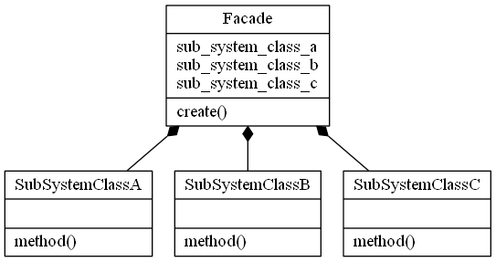
Design Patterns
Singleton, Observer, (A)Factory, MVC
Strategy
Iterator
Façade
State

Slide 4
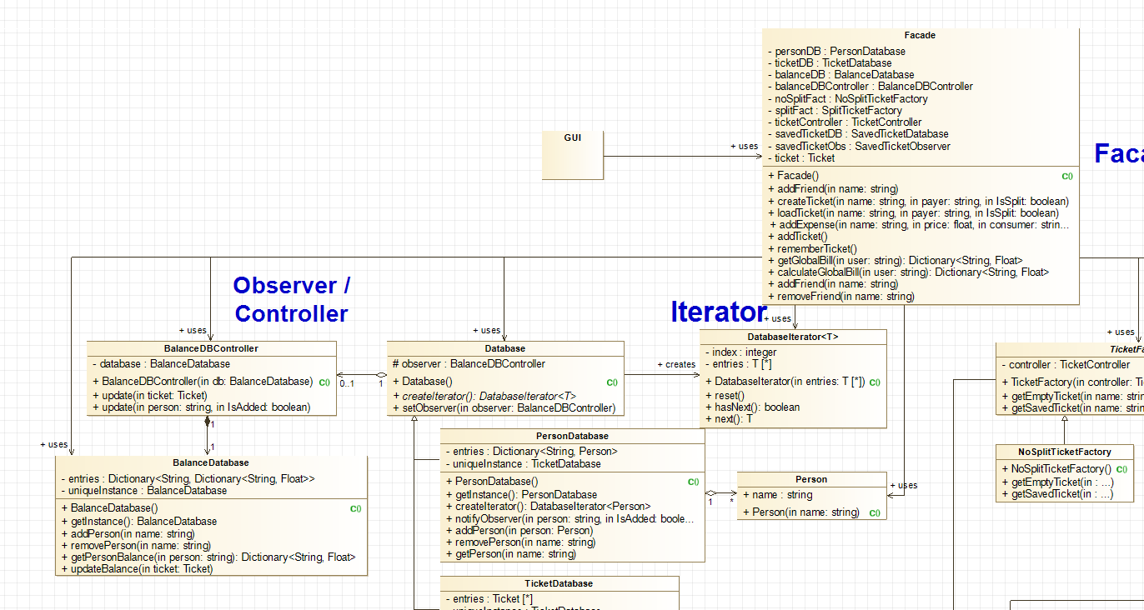
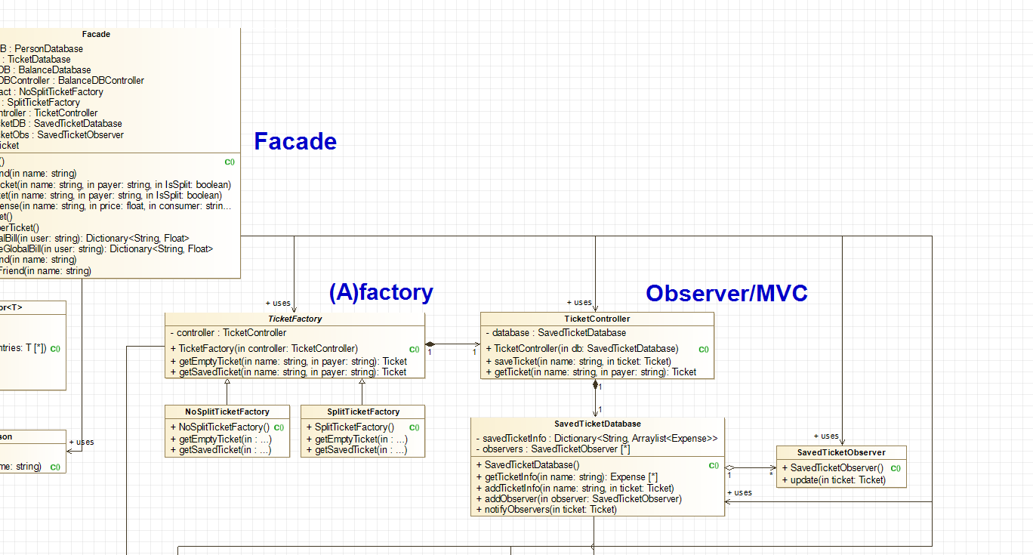
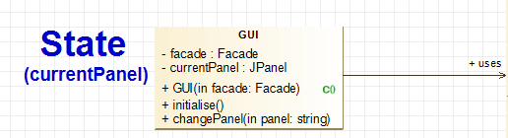
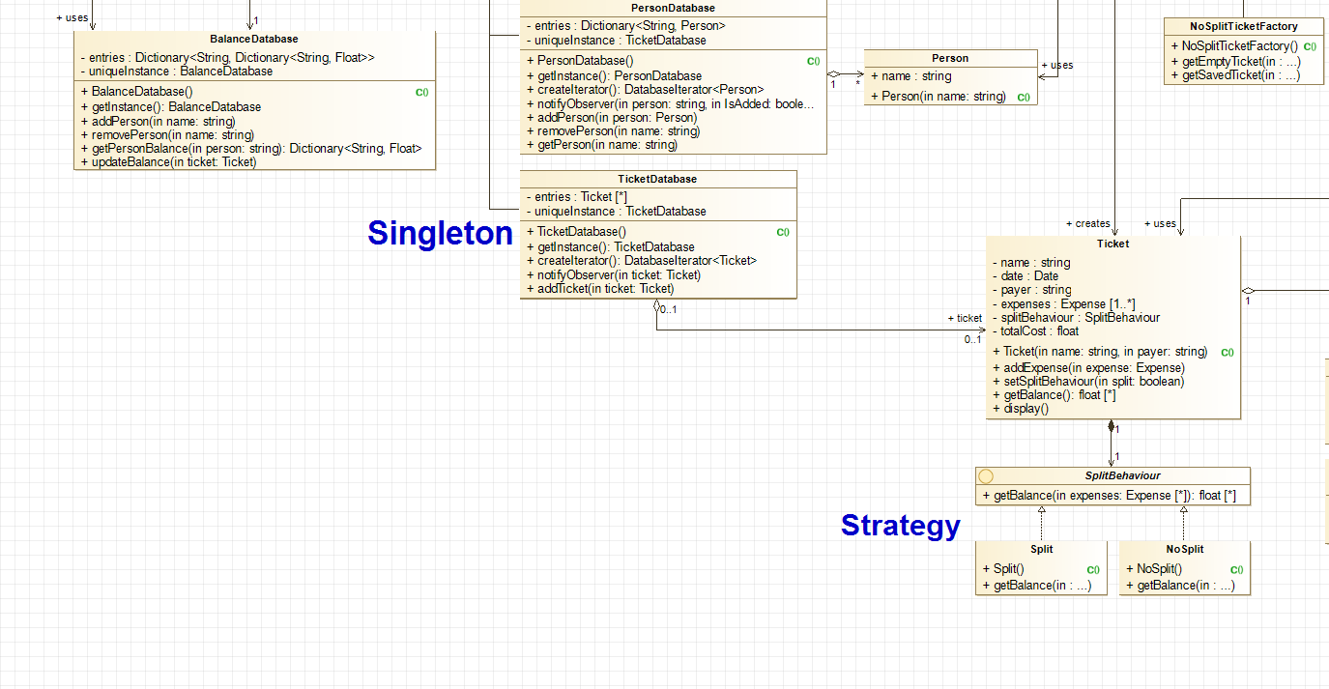
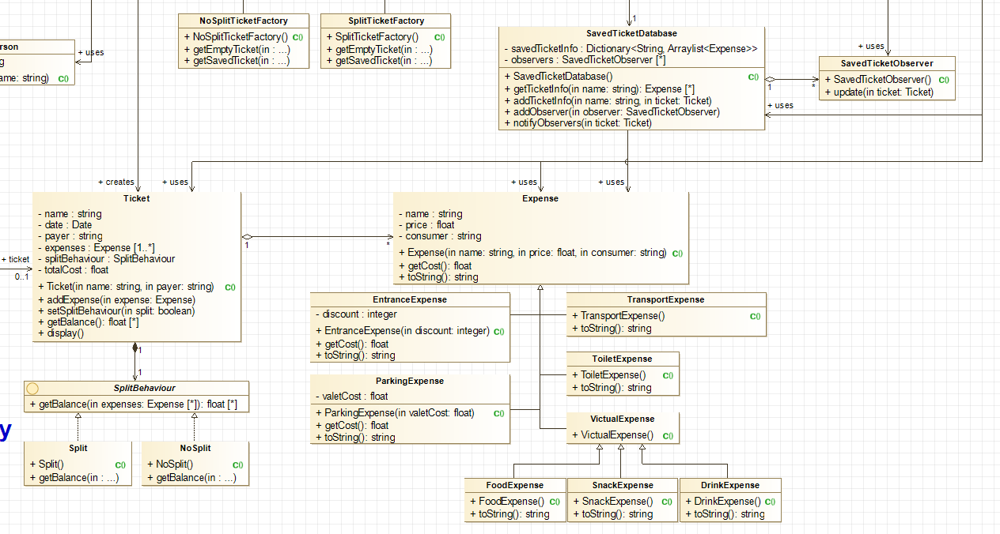

Slide 5
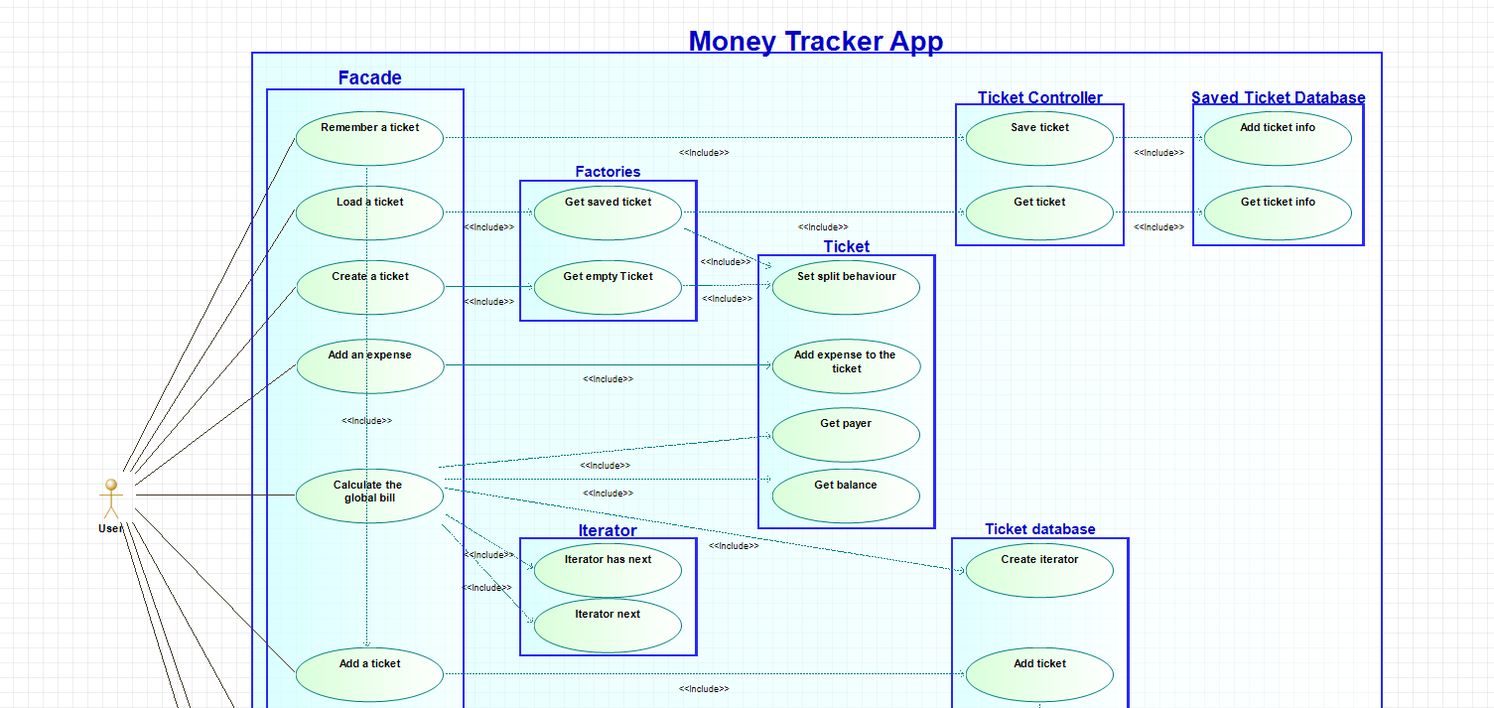
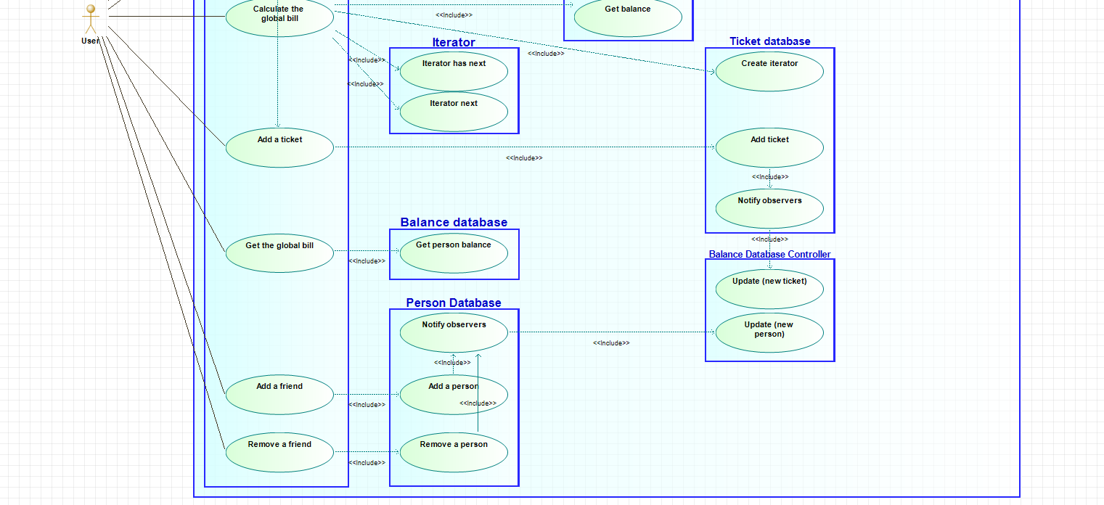

Slide 6
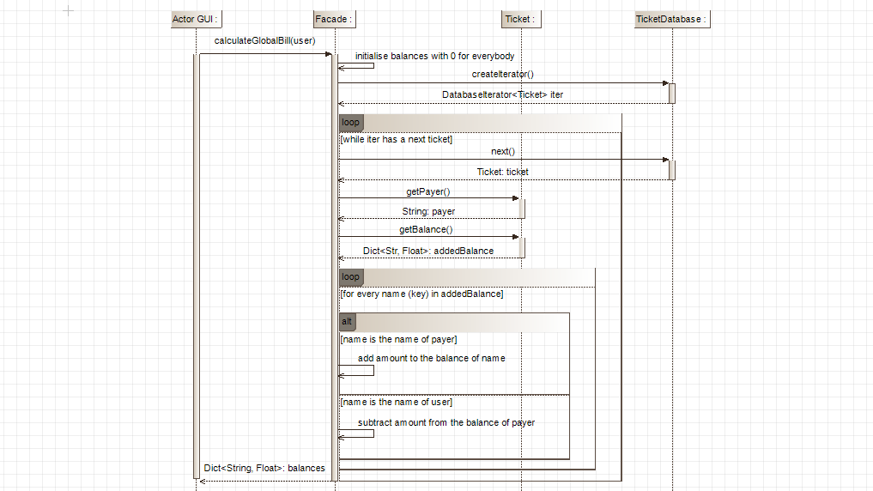
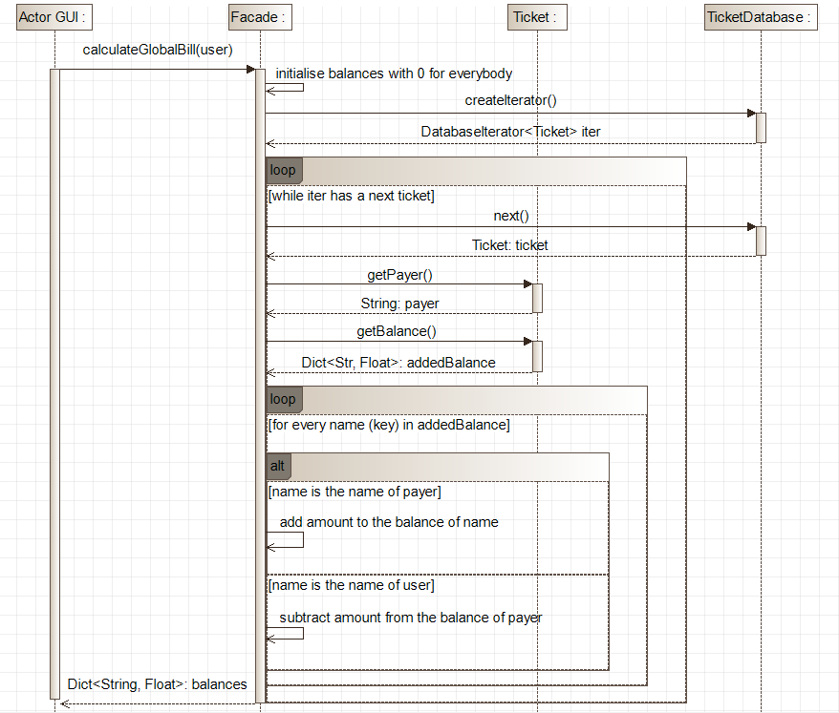
Diagrams

Slide 7
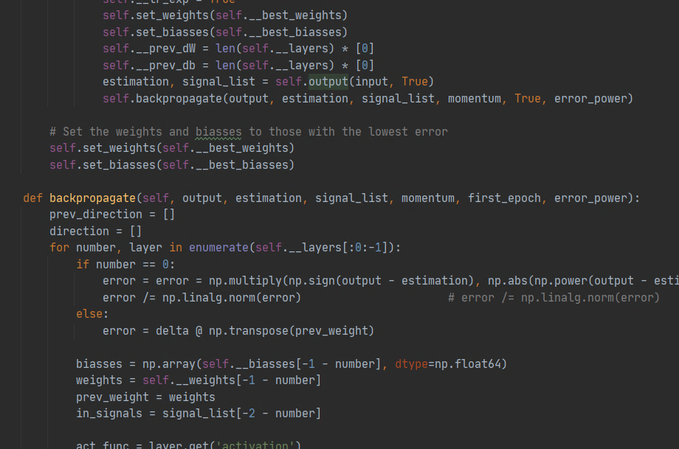
Tests
Integration Test (from Ticket)
Unit Tests (from Ticket)
getExpenses() from Ticket
getName()
getPayer()
addExpense()
getExpenses()
setSplitBehaviour()

Slide 8

Our Secret Sauce
Facade for total seperation
Fast Balance Retrieval
Save & Reuse Tickets

Slide 9

Demonstration
Universiteit
Antwerpen
5–Software Design

